Slide 1
Ai.rty
Be your own fashion designer!

Slide 2
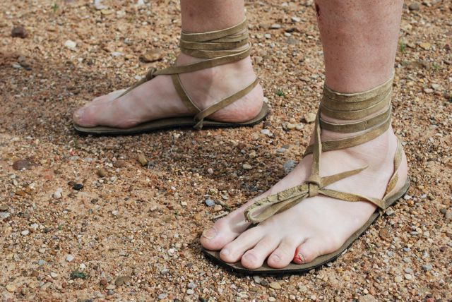
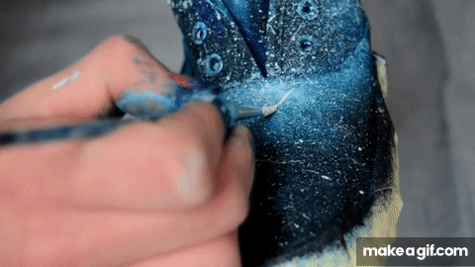
Prehistoric times
You or relative makes your shoes
Customizable to a small extent
Recently
Hard work for DIY customization

Slide 3
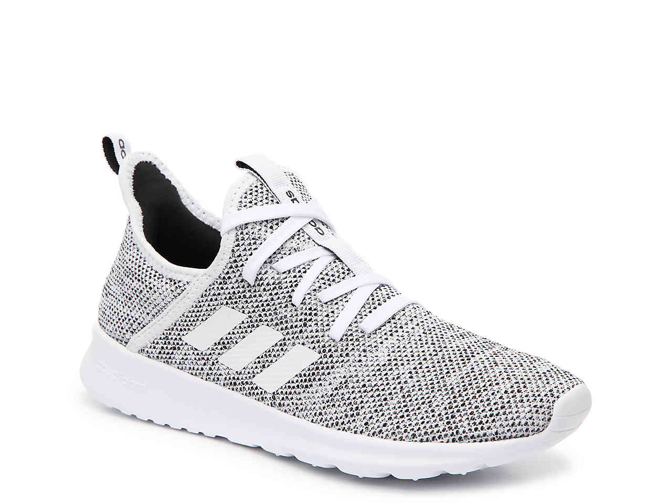
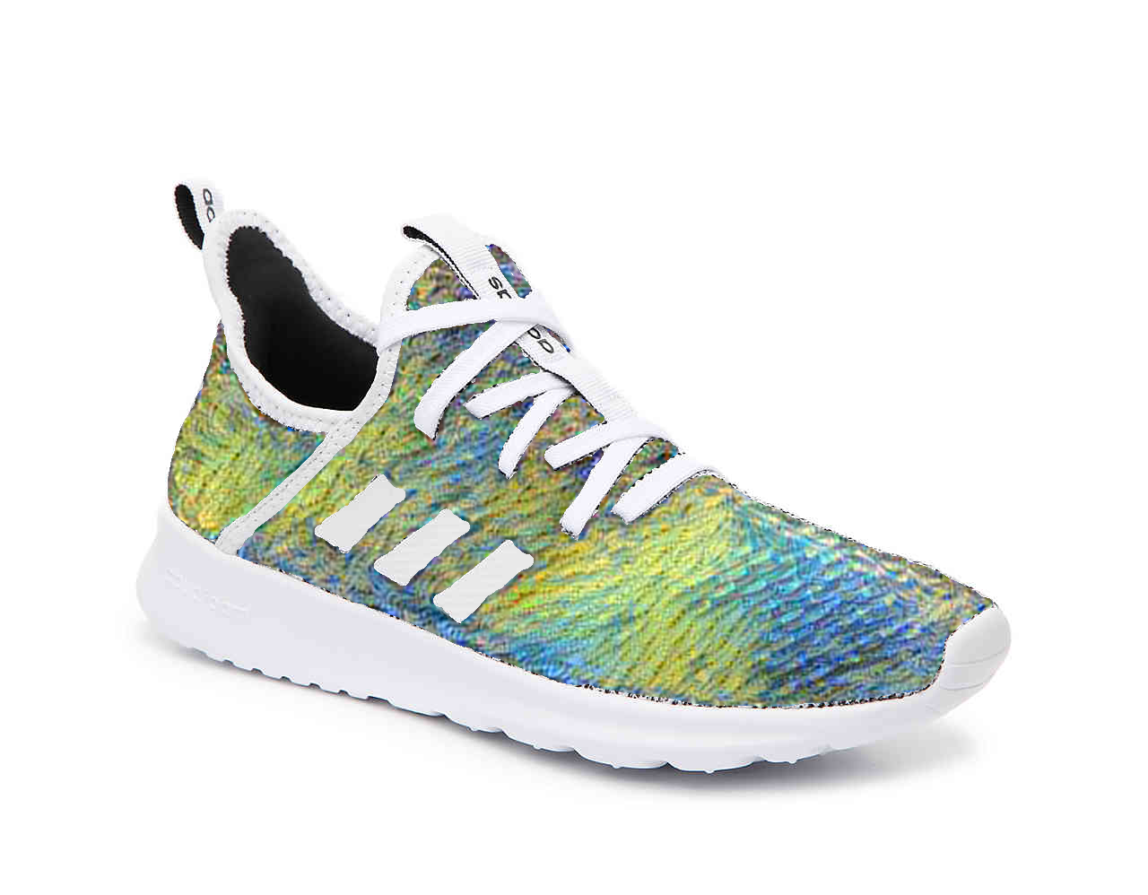
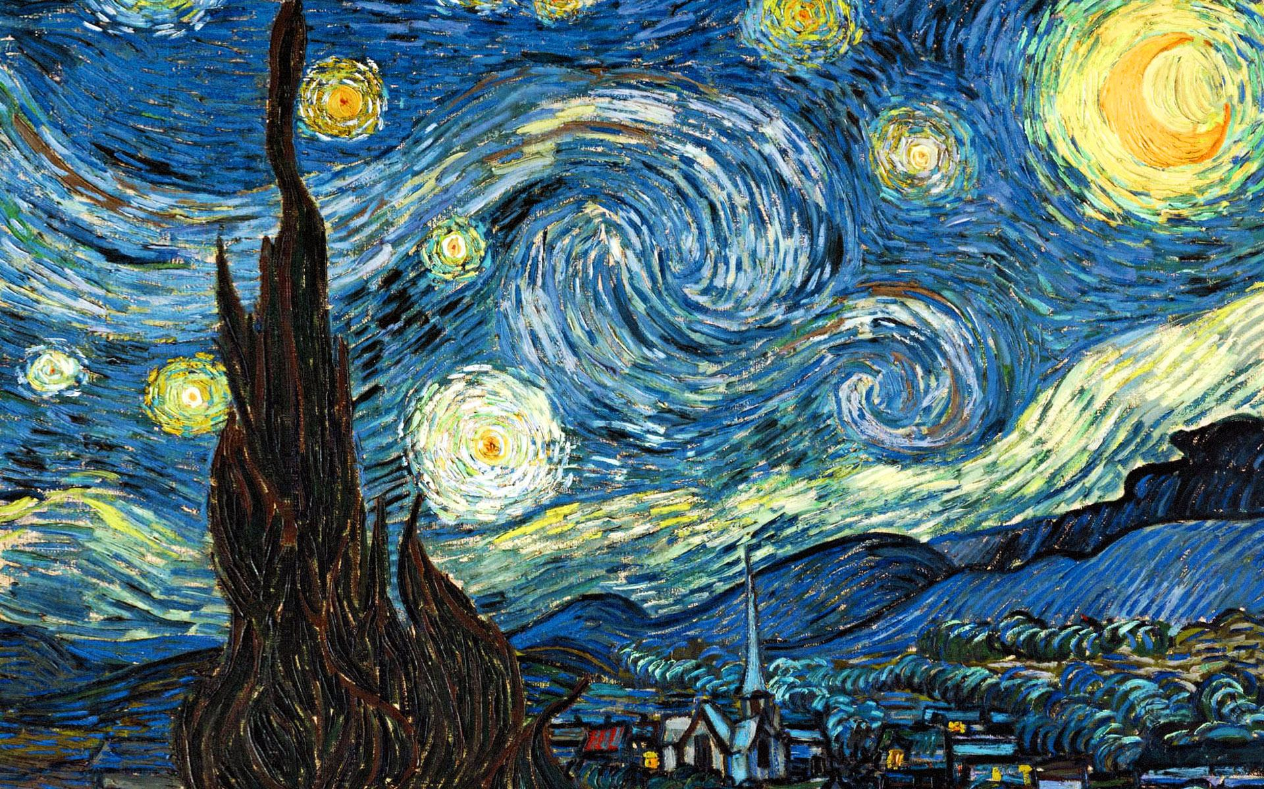
Renaissance
+
=

Slide 4
Demo

Slide 5
Value for stakeholders
Customers
Adidas
Personalized shopping experience
Increases app time usage of customers
First-to-market
Makes clever use of latest 3D-printing technologies
Possessing unique adidas products
Broadens customer segment
People willingly share their custom adidas products on social media

Slide 6




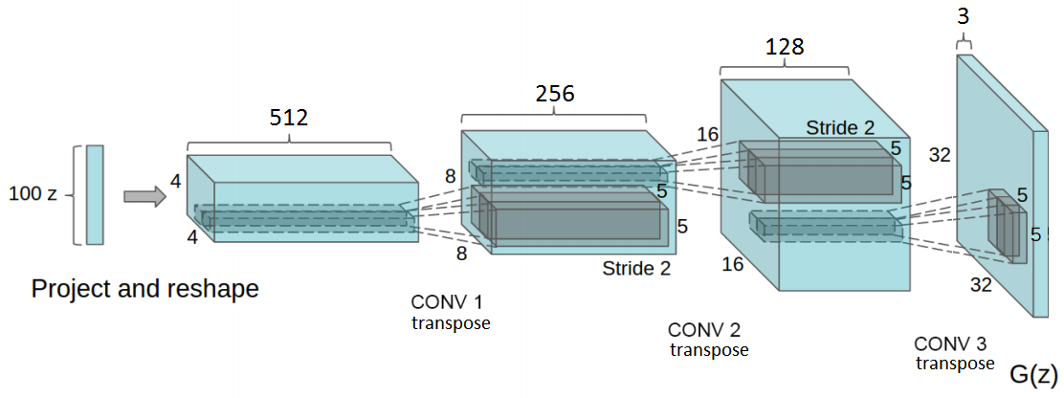
How do we do this?
DCGAN

Slide 7
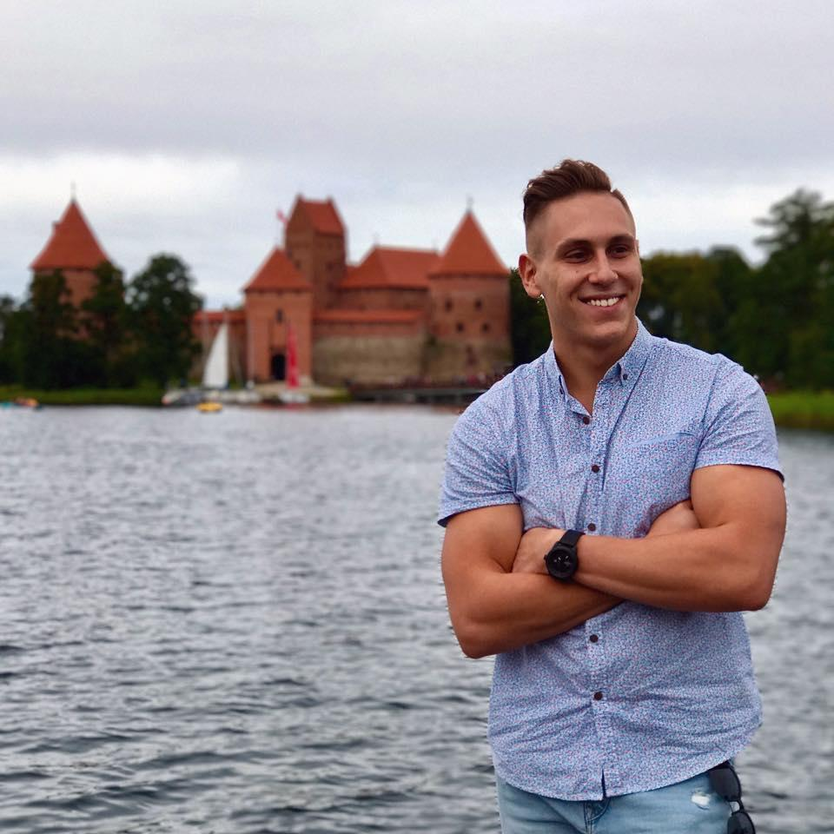
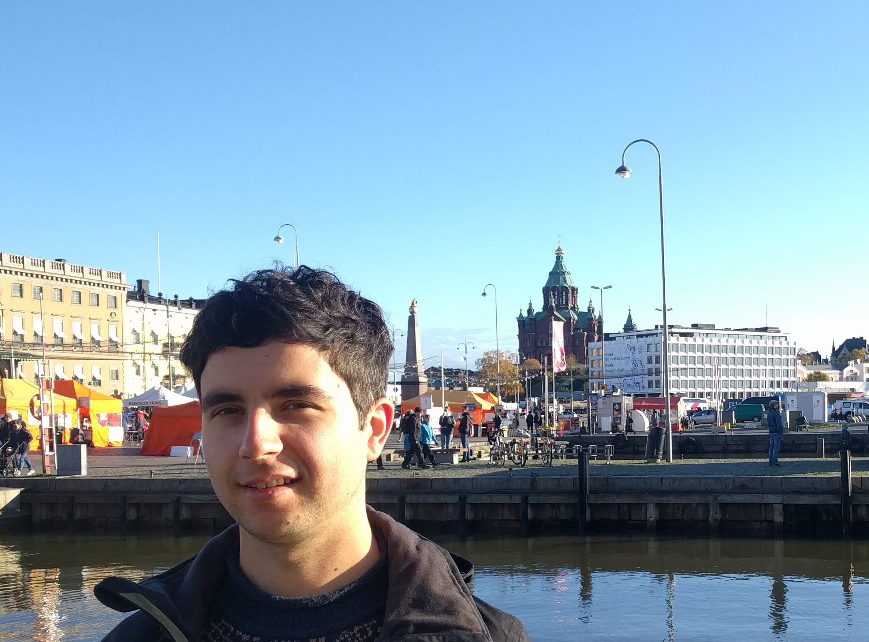
The team
Nicolae Righeriu
Tomas Komar
Tomas Šostak
Jeroen Brouns
Suraj Iyer

Slide 8
Thank you for your attention!
Ai.rty

Slide 9
Q & A
Ai.rty

